Slide 1
Quantitative Analysis in Business Studies
MAN00035C
2026 - Week 7

Slide 2
Week 7: ANOVA
Reading: Taylor – Chapter 8

Slide 3
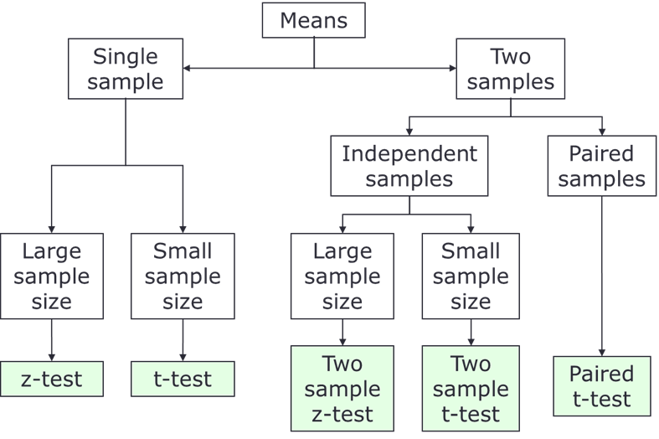
Where are we?
Test for a mean/proportion, or the difference of two means (see the figure)
Test if there is any association between categories in a two-way table. (Chi^2 test)
This week: test the mean difference of more than 2 groups (Anova)

Slide 4
Steps for carrying out a hypothesis test
Step 1. Set up the null and alternative hypotheses
Step 2. Decide on the significance level (normally alpha=5%) and determine the critical values
Step 3. Calculate the test statistic
Step 4. Decide whether to accept or reject the null hypothesis
You need to discuss the assumptions and draw a conclusion as well

Slide 5
T-test vs. ANOVA (1)
2-sample t-test
Means of 2 unrelated samples:
e.g. Is there any difference between the mean starting salaries of men and women in a particular firm?
H₀ : μ _{m} = μ _{w}
H₁ : μ _{m} ≠ μ _{w}
(One-way) Analysis of Variance
Means of more than 2 unrelated samples:
e.g. Is there any difference between the average starting salaries for employees in four different departments in the firm?
H₀: μ₁ = μ₂ = μ₃ = μ₄
H₁: μ₁ ≠ μ₂ or μ₁ ≠ μ₃ or μ₁ ≠ μ₄
or μ₂ ≠ μ₃ or μ₃ ≠ μ₄

Slide 6
T-test vs. ANOVA (2)
ANOVA can be thought of as an extension of the two-sample t-test to 3 or more groups of data.
(You can use it for just two groups too. It ends up the same as our “small sample” test, which is the SPSS “equal variances” one.)
Assumptions for T-test and ANOVA test:
1. observations are independent
2. the variances are equal across groups (homoscedasticity)
3. The data within each group should follow a normal distribution.
In t-test, we commonly considered a difference divided by a standard error in the last topic. That will change today. (F-test)

Slide 7
What would data look like?
Lets look at how suitable data might be represented in a dataset:
So, we are NOT actually looking at two or more different continuous variables, but one, with the groups defined by another, categorical, variable.
Height | College
1.56 | A
1.78 | V
1.54 | C
1.70 | D
1.70 | J
1.83 | H
1.73 | G
1.63 | L

Slide 8
The Layout
ANOVA follows the same thought process as we used last week
Step 1. Set up the null ((no relationship, i.e µ_{A}= µ_{C} = µ_{D}) and alternative hypotheses
If we reject the null, we find that at least one group is different to the rest.
However, we don’t know if it’s one group or more than one, which group(s) they are, or …
Step 2. Decide on the significance level (normally p<5%) and determine the critical values
Step 3. Calculate the test statistic
Step 4. Decide whether to accept or reject the null hypothesis

Slide 9
Why can’t we just do a lot of two-sample t-tests?
One test (5%): P(correct) = 0.95; P(incorrect) = 0.05
More than one test for comparison:
Obviously, this probability of error not acceptable.
If the pairwise tests are not independent, we cannot even do this calculation.
ANOVA compares all means simultaneously
No. of samples | Pairwise tests | P(all correct) | P{at least one incorrect
2 | 1 | 0.95 | 0.05
3 | 3 | 0.95³ = 0.875 | 0.125
n | {n(n-1)}/2 | 0.95^{n} | 1 – 0.95^{n}
10 | 45 | 0.95⁴⁵ | 0.90

Slide 10

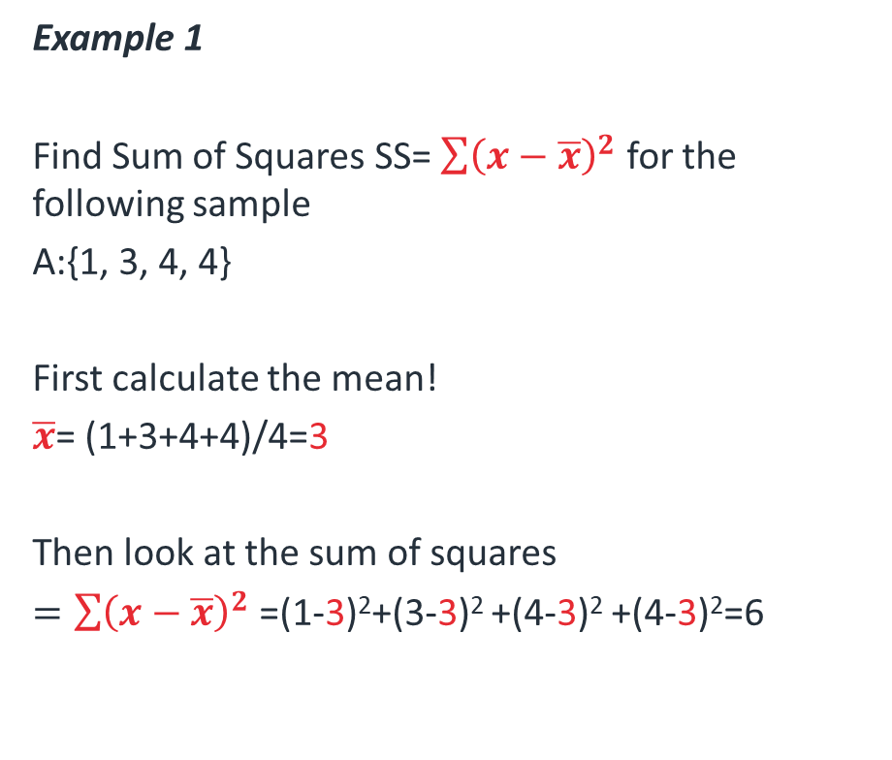
Recap
Example 1
Find Sum of Squares SS= $\sum{{\left(x−\overline{x}\right)}^{2}}$ for the following sample
A:{1, 3, 4, 4}
First calculate the mean!
$\overline{x}$= (1+3+4+4)/4=3
Then look at the sum of squares
$=\sum{{\left(x−\overline{x}\right)}^{2}}$=(1-3)²+(3-3)² +(4-3)² +(4-3)²=6
Analysis of Variance
Standard deviation: $s=\sqrt{\frac{\sum{{\left(x−\overline{x}\right)}^{2}}}{n−1}}$
Variance: s²⁼ $\frac{\sum{{\left(x−\overline{x}\right)}^{2}}}{n−1}$
Notes:
Sum of squares

Slide 11

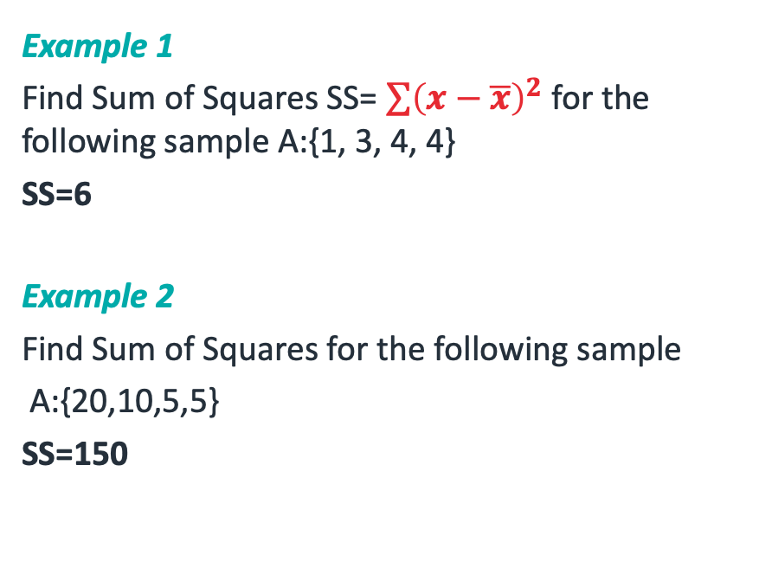
Recap
Example 1
Find Sum of Squares SS= $\sum{{\left(x−\overline{x}\right)}^{2}}$ for the following sample A:{1, 3, 4, 4}
SS=6
Example 2
Find Sum of Squares for the following sample
A:{20,10,5,5}
SS=150
Analysis of Variance
Standard deviation: $s=\sqrt{\frac{\sum{{\left(x−\overline{x}\right)}^{2}}}{n−1}}$
Variance: s²⁼ $\frac{\sum{{\left(x−\overline{x}\right)}^{2}}}{n−1}$
Notes:
Sum of squares

Slide 12
Intuition to ANOVA (1)
ANOVA looks at some measure of variation of the data taking all the data points together, and splits that up into two types.
The chosen measure of variation is the “sum of the squares of the differences”.
The two types:
a) Variation between the group means (a.k.a. actual differences between the groups, a signal)
b) Other variation, within the groups, put down to “errors” at this stage (a.k.a. noise)

Slide 13
Intuition to ANOVA (2)
Some of the variation (the signal) in the data is due to the fact that the means truly are different.
Some of it is due to noise.
We are going to try to separate the two.
Total
Signal
Noise

Slide 14
Intuition to ANOVA (3)
The more different the means, the bigger the signal and the easier it is to see that they are actually different.
This is good for us.
Total
Signal
Noise

Slide 15
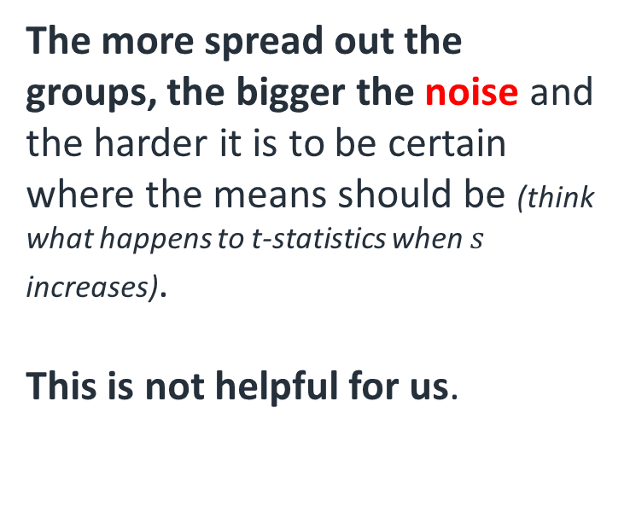
Intuition to ANOVA (4)
The more spread out the groups, the bigger the noise and the harder it is to be certain where the means should be (think what happens to t-statistics when $s$ increases).
This is not helpful for us.
Total
Signal
Noise

Slide 16
Two things to note (1)
However, it’s worth noting a couple of things first.
1) We can change the signal without changing the noise by moving entire groups:
(So long as one counterbalances the other, this leaves the black line in the same place.)
Total
Signal
Noise

Slide 17
Two things to note (2)
However, it’s worth noting a couple of things first.
2) We can change the noise without changing the signal by moving datapoints:
(So long as one counterbalances the other, this leaves the black line in the same place.)
Total
Signal
Noise

Slide 18
An Example (1)
It is easier to see what actually goes on with a suitable example.
There are two ways we can present the data.
This is how the computer would like to see it:
Scores from formative tests
Data | Group
2 | A
4 | A
4 | B
5 | B
6 | B
2 | C
3 | C
9 | C
10 | C
This is probably better for us:
Group | Data |  |  |  | mean
A | 2 | 4 |  |  | 3
B | 4 | 5 | 6 |  | 5
C | 2 | 3 | 9 | 10 | 6

Slide 19
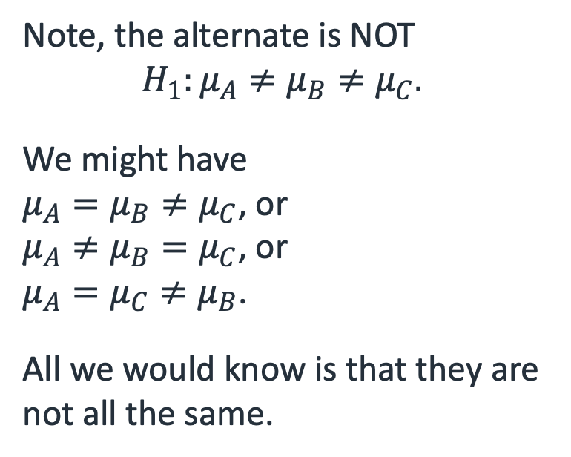
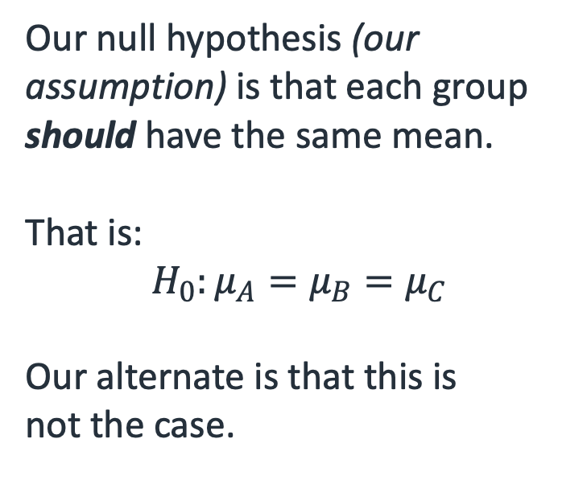
An Example (2)
Our null hypothesis (our assumption) is that each group should have the same mean.
That is:
$$H_{0}:μ_{A}=μ_{B}=μ_{C}$$
Our alternate is that this is not the case.
Note, the alternate is NOT
$$H_{1}:μ_{A}≠μ_{B}≠μ_{C}.$$
We might have
$μ_{A}=μ_{B}≠μ_{C}$, or $μ_{A}≠μ_{B}=μ_{C}$, or $μ_{A}=μ_{C}≠μ_{B}$.
All we would know is that they are not all the same.

Slide 20
An Example (3)
9
We can put this on a diagram.
(Not necessary for answering the question, but maybe helpful to illustrate what we are doing)
(We have also implicitly already calculated the mean of each group (3, 5 and 6 respectively).)
7
5
3
1
A
B
C
Total
Signal
Noise

Slide 21
An Example (4)
9
Note that the mean of the datapoints and the (weighted) mean of the means of the groups are the same (the black bar).
This is a good check that you’ve found the group means correctly.
7
5
3
1
A
B
C
Total
Signal
Noise

Slide 22
An Example (5)
9
For each datapoint, we are going to look at three differences:
Group mean to grand mean
2) Datapoint to group mean
3) Datapoint to grand mean
7
5
3
1
A
B
C
Total
Signal
Noise
Notes:
Signal – SSW –the sum of squares within groups
Noise – SSB – the sum of squares between groups

Slide 23



Signal (1)
9
We look at each distance between group means and the grand mean
7
$$1$$
5
$$−2$$
$$0$$
3
1
Signal

Slide 24

Signal (2)
9
We look at each distance, squared,
7
$$1$$
5
$$4$$
$$0$$
3
1
Signal

Slide 25


Signal (3)
9
We look at each distance, squared, “for each datapoint”, so that’s twice, three times, and four times.
7
$$4$$
5
$$8$$
$$0$$
3
1
Signal

Slide 26
Signal (4)
9
We look at each distance, squared, “for each datapoint”, so that’s twice, three times, and four times.
We sum them to get our signal: 12.
7
$$4$$
5
$$8$$
$$0$$
3
1
Signal

Slide 27









Noise (1)
$$4$$
9
$$3$$
Again, we look at the distances between each datapoint and its group mean
7
$$1$$
5
$$0$$
$$1$$
$$−1$$
3
$$−3$$
$$−1$$
$$−4$$
1
A
B
C
Noise

Slide 28







Noise (2)
$$16$$
9
$$9$$
Again, we look at the distances, squared
7
$$1$$
5
$$0$$
$$1$$
$$1$$
3
$$9$$
$$1$$
$$16$$
1
A
B
C
Noise

Slide 29
Noise (3)
$$16$$
9
$$9$$
Again, we look at the distances, squared, and summed:
A: 2
B: 2
C: 50
Noise: 54
7
$$1$$
5
$$0$$
$$1$$
$$1$$
3
$$9$$
$$1$$
$$16$$
1
A
B
C
Noise
(Quite a bit bigger than the signal…)

Slide 30
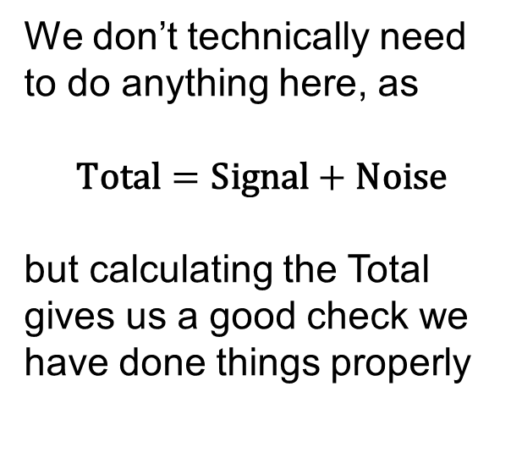
Total (1)
9
We don’t technically need to do anything here, as
$$\text{Total}=\text{Signal}+\text{Noise}$$
but calculating the Total gives us a good check we have done things properly
7
5
3
1
A
B
C
Total

Slide 31









Total (2)
$$5$$
9
$$4$$
Once again, it’s the distances
7
$$1$$
5
$$0$$
$$−1$$
$$−1$$
3
$$−2$$
$$−3$$
$$−3$$
1
A
B
C
Total

Slide 32







Total (3)
$$25$$
9
$$16$$
Once again, it’s the distances, squared
7
$$1$$
5
$$0$$
$$1$$
$$1$$
3
$$4$$
$$9$$
$$9$$
1
A
B
C
Total

Slide 33
Total (4)
$$25$$
9
$$16$$
Once again, it’s the distances, squared, and summed:
A: 10
B: 2
C: 54
Total: 66
7
$$1$$
5
$$0$$
$$1$$
$$1$$
3
$$4$$
$$9$$
$$9$$
1
A
B
C
Total

Slide 34
Total (5)
$$25$$
9
$$16$$
Once again, it’s the distances, squared, and summed:
A: 10 =8+2
B: 2 =0+2
C: 54 =4+50
Total: 66=12+54
7
$$1$$
5
$$0$$
$$1$$
$$1$$
3
$$4$$
$$9$$
$$9$$
1
A
B
C
Total

Slide 35
Total = Signal + Noise
Group | Data |  |  |  | mean
A | 2 | 4 |  |  | 3
B | 4 | 5 | 6 |  | 5
C | 2 | 3 | 9 | 10 | 6
Total variation= (variation between group means) + (error variation not due to the group means)
SST = SSG + SSE
The next session: We finalise the test as:
Source | SS | df | MSS | F
Groups (Signal) | 12
Errors (Noise) | 54
Total | 66
Source | SS | df | MSS | F
Groups (Signal) | 12 | 2 | 6 | 0.667
Errors (Noise) | 54 | 6 | 9
Total | 66 | 8

Slide 36
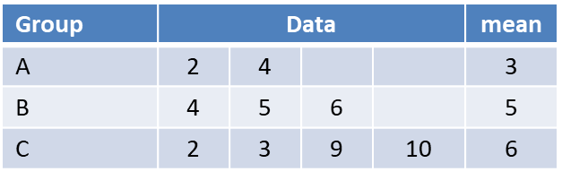

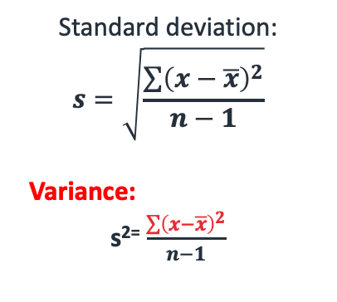
From the previous lecture
$H_{0}:μ_{A}=μ_{B}=μ_{C}$ vs $H_{1}:NOT{ H}_{0}$
We had arrived here at the end of the last lecture:
Standard deviation:
$$s=\sqrt{\frac{\sum{{\left(x−\overline{x}\right)}^{2}}}{n−1}}$$
Variance:
s²⁼ $\frac{\sum{{\left(x−\overline{x}\right)}^{2}}}{n−1}$

Slide 37
9
We had arrived here at the end of the last lecture:
Signal: sum of squared differences of each (observation’s) group mean from the grand mean
Noise: sum of the squared differences of each datapoint from its group mean
7
5
3
1
A
B
C
Total
SST
Signal
SSG
Noise
SSE

Slide 38
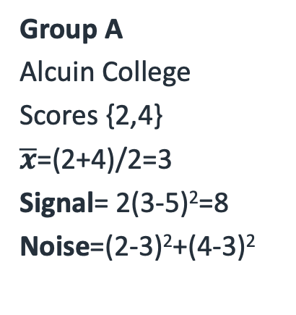
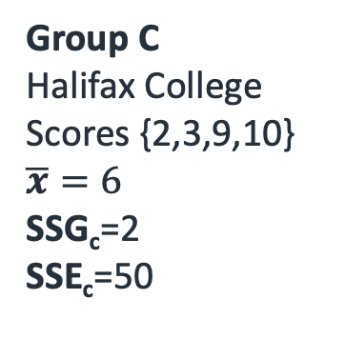
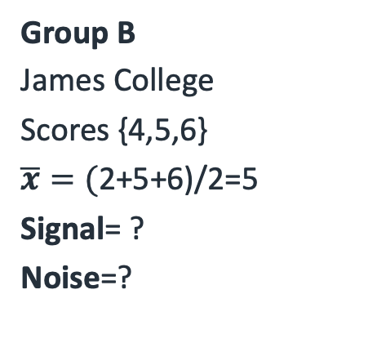
Scores from formative tests (1)
Do students score differently across colleges?
Grand mean= (2+4+2+5+6+2+3+9+10)/9=5
Group A
Alcuin College
Scores {2,4}
$\overline{x}$=(2+4)/2=3
Signal= 2(3-5)²=8
Noise=(2-3)²+(4-3)²
Group B
James College
Scores {4,5,6}
$\overline{x}=($2+5+6)/2=5
Signal= ?
Noise=?
Group C
Halifax College
Scores {2,3,9,10}
$$\overline{x}=6$$
SSG_{c}=2
SSE_{c}=50

Slide 39
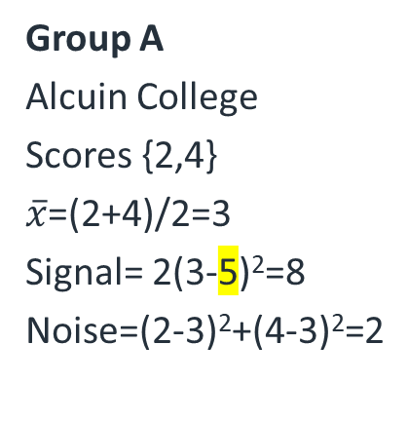
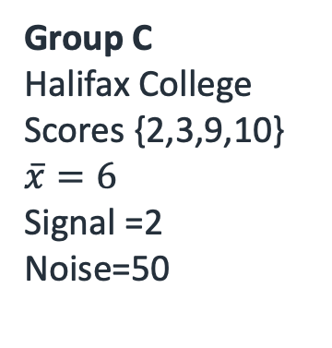
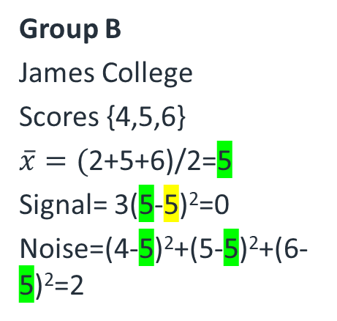
Scores from formative tests (2)
Do students score differently across colleges?
Grand mean= (2+4+2+5+6+2+3+9+10)/9=5
Group A
Alcuin College
Scores {2,4}
$\overline{x}$=(2+4)/2=3
Signal= 2(3-5)²=8
Noise=(2-3)²+(4-3)²=2
Group B
James College
Scores {4,5,6}
$\overline{x}=($2+5+6)/2=5
Signal= 3(5-5)²=0
Noise=(4-5)²+(5-5)²+(6-5)²=2
Group C
Halifax College
Scores {2,3,9,10}
$$\overline{x}=6$$
Signal =2
Noise=50

Slide 40
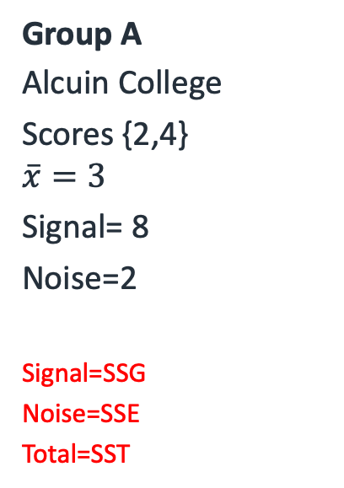
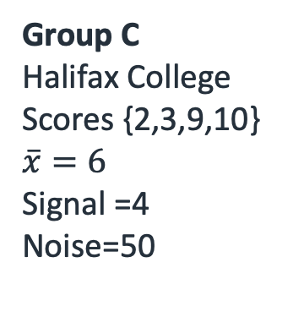
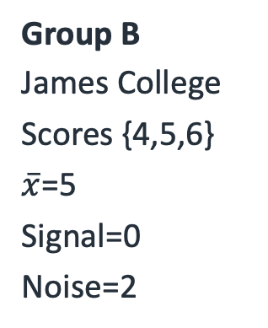
Scores from formative tests (3)
Do students score differently across colleges?
Group A
Alcuin College
Scores {2,4}
$$\overline{x}=3$$
Signal= 8
Noise=2
Signal=SSG
Noise=SSE
Total=SST
Group B
James College
Scores {4,5,6}
$\overline{x}$=5
Signal=0
Noise=2
Group C
Halifax College
Scores {2,3,9,10}
$$\overline{x}=6$$
Signal =4
Noise=50
Source | SS | df | MSS | F
Groups (Signal) | 12
Errors (Noise) | 54
Total | 66

Slide 41
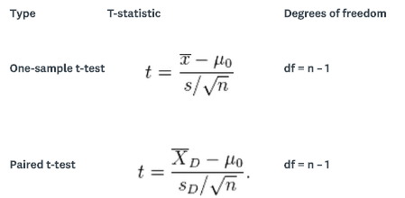
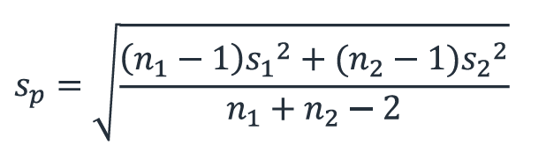

Degrees of Freedom (1)
Standard deviation:
$$s=\sqrt{\frac{\sum{{\left(x−\overline{x}\right)}^{2}}}{n−1}}$$
In general, degrees of freedom (df) is the number of values in the calculation of a statistic that are free to vary.
In this module, it always arises from calculation of s or SS.
Two-sample independent t-test:
df=n₁ + n₂ - 2

Slide 42
Degrees of Freedom (2)
Remember, we can manipulate the signal and the noise independently.
How many ways can I manage that?
Source | SS | df | MSS | F
Groups (Signal) | 12
Errors (Noise) | 54
Total | 66

Slide 43
Degrees of Freedom, Signal
I have 3 groups, so I can slide group A to wherever I want, so long as B and C counterbalance.
I can then slide B wherever I want, so long as C counterbalances.
A and B can both be set as I want without changing the noise.
df(Signal) = number of groups - 1
(Or I could set A and C, or B and C. Whichever, it’s still two, one must counterbalance.)

Slide 44
From the previous session…
df(Signal) = df(SSG)= number of groups - 1
Source | SS | df | MSS | F
Groups (Signal) | 12 | 2
Errors (Noise) | 54
Total | 66
Total
Signal
Noise

Slide 45
Degrees of Freedom, Noise
I have 2 data points in group A, so can set 1 where I want. 1 df.
… 3 in group B, so can set 2, so 2 df.
… 4 in C, so can set 3, so 3 df.
1 degree of freedom in the noise for A, 2 from B, 3 from C, so that’s 6 in total.
df(Noise) =
number of datapoints – number of groups
We can add that to the table too.

Slide 46
From the previous session…
df(Noise) = df(SSE)=
number of datapoints – number of groups
Source | SS | df | MSS | F
Groups (Signal) | 12 | 2
Errors (Noise) | 54 | 6
Total | 66
Total
Signal
Noise

Slide 47
Degrees of Freedom, Total
In total, we have 9 datapoints (2 from A, 3 from B, 4 from C).
In exactly the same way, I can freely move 8 of them, so long as the 9th counterbalances.
8 freely chosen. 8 df.
It seems reasonable then that the total degrees of freedom should be 2+6=8.
And this is indeed the case.

Slide 48
Degrees of Freedom, summary
Source | SS | df | MSS | F
Groups (Signal) | 12 | 2
Errors (Noise) | 54 | 6
Total | 66 | 8

Slide 49
Degrees of Freedom, summary
We use the degrees of freedom to adjust our measures.
If there are three times as many ways to manipulate the noise as the signal, we might expect it to be three times as big?
We divide our measures (the Sums of Squares (SS)) by the degrees of freedom.
This gives the Mean Sums of Squares (MSS), a better measure of signal and noise.

Slide 50
Mean Sums of Squares
We have our better measures:
Source | SS | df | MSS | F
Groups (Signal) | 12 | 2 | 6
Errors (Noise) | 54 | 6 | 9
Total | 66 | 8

Slide 51
Lastly, F-test (1)
And then lastly we compare the signal to the noise.
How much bigger (or smaller) is the signal than the noise?
We do this through division.
MSSsignal/MSSnoise
Much as with the Coefficient of Variation, we care about the difference in a relative fashion, not an absolute one.

Slide 52
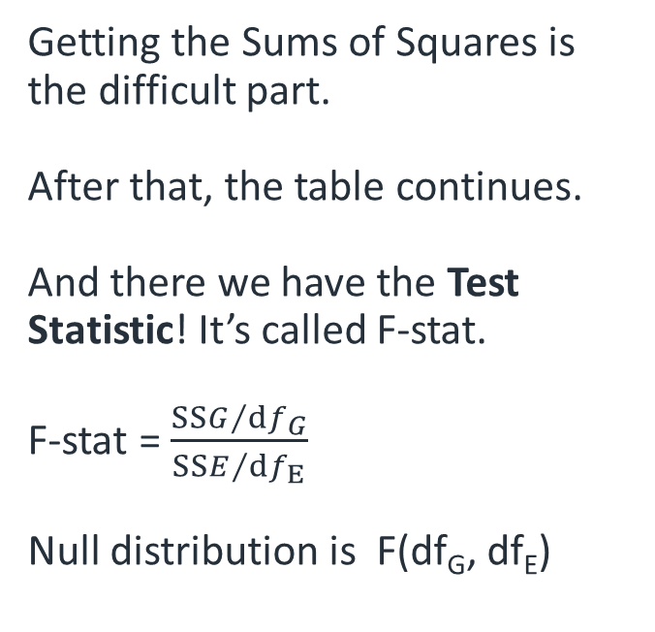
F-test (2)
Getting the Sums of Squares is the difficult part.
After that, the table continues.
And there we have the Test Statistic! It’s called F-stat.
F-stat = $\frac{SSG/ⅆf_{G}}{SSE/ⅆf_{E}}$
Null distribution is F(df_{G}, df_{E})
Source | SS | df | MSS | F
Groups (Signal) | 12 | 2 | 6 | 0.667
Errors (Noise) | 54 | 6 | 9
Total | 66 | 8
÷
=
–
=
+
+
÷
=
=
=

Slide 53
F-test (3)
This gets compared to a critical value.
In this case CV=5.14. Since TS < CV, we fail to reject the null, and don’t find a significant difference between the means.
(There isn’t going to be a table distributed, the critical F-value will be given to you in this course.)
Group | Data |  |  |  | mean
A | 2 | 4 |  |  | 3
B | 4 | 5 | 6 |  | 5
C | 2 | 3 | 9 | 10 | 6
Source | SS | df | MSS | F
Groups (Signal) | 12 | 2 | 6 | 0.667
Errors (Noise) | 54 | 6 | 9
Total | 66 | 8

Slide 54
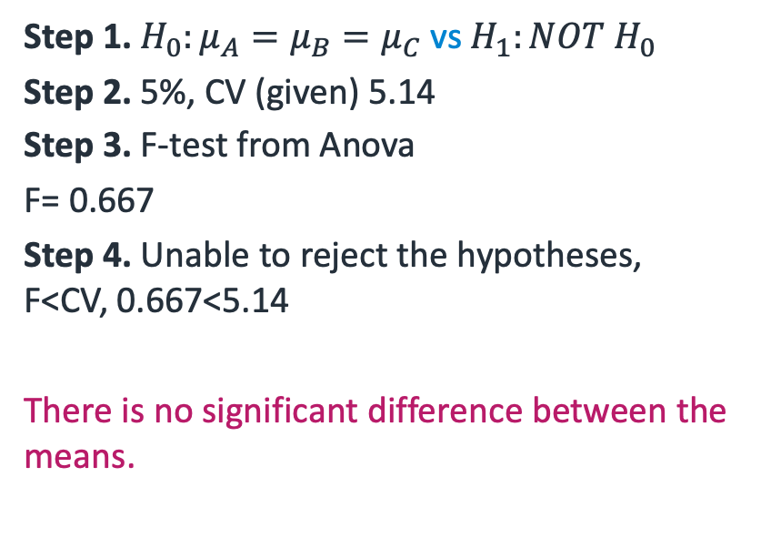
Steps for carrying out a hypothesis test
Step 1. $H_{0}:μ_{A}=μ_{B}=μ_{C}$ vs $H_{1}:NOT{ H}_{0}$
Step 2. 5%, CV (given) 5.14
Step 3. F-test from Anova
F= 0.667
Step 4. Unable to reject the hypotheses, F<CV, 0.667<5.14
There is no significant difference between the means.
Step 1. Set up the null and alternative hypotheses
Step 2. Decide on the significance level (normally p<5%) and determine the critical values
Step 3. Calculate the test statistic
Step 4. Decide whether to accept or reject the null hypothesis

Slide 55
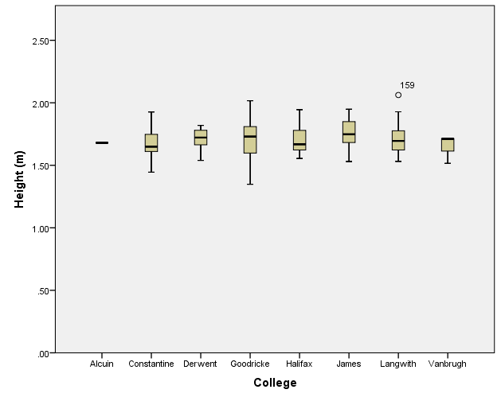
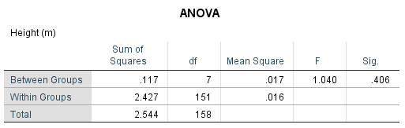
SPSS and ANOVA
We will do ANOVA in the computer practical sessions. Process will be faster but the output should be familiar!

Slide 56
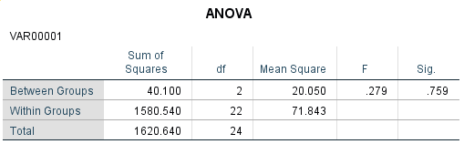
?

Slide 57
Conclusions
Step 1. Set up the null (no relationship, i.e µ_{A}= µ_{C} = µ_{D}) and alternative hypotheses
If we reject the null, we find that at least one group is different to the rest.
Step 2. Decide on the significance level (normally p<5%) and determine the critical values
Step 3. Calculate the test statistic (F-stat)
Step 4. Decide whether to accept or reject
the null hypothesis
Source | SS | df | MSS | F
Groups (Signal)
Errors (Noise)
Total
Next session: Another example and Anova using calculator

Slide 58
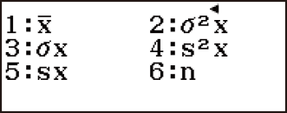


Short cut – using your calculator
Instead of the point by point calculation of the distance, squaring, and then summing,
we can make use of the definition of sample variance s^2:
$$s^{2}=\frac{\sum{{\left(x−\overline{x}\right)}^{2}}}{n−1}$$
$$σ_{n}^{2}=\frac{\sum{{\left(x−\overline{x}\right)}^{2}}}{n}$$
$$\sum{{\left(x−\overline{x}\right)}^{2}}=(n−1)s^{2}$$

Slide 59
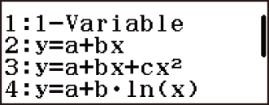
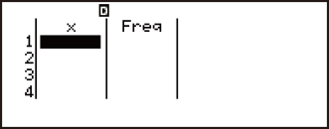
Short cut – using your calculator
Perform the steps below to start a statistical calculation.
Press , select the Statistics Mode icon, and then press .
Press , select 1-Variable
CASIO Statistical Calculations (85GT/X)

Slide 60
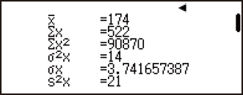
Short cut – using your calculator
3. Input a value and press .
Repeat this step until all the datapoints are inputted.
4. Display statistical values based on input data. Press
Then select 1-Variable Calc
CASIO Statistical Calculations (85GT/X)

Slide 61

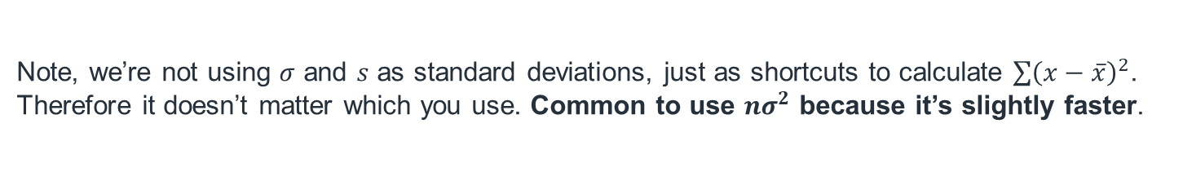

Short cut – using your calculator
It is more convenient to use the estimate for population variance $σ^{2}$
$$\sum{{\left(x−\overline{x}\right)}^{2}}=nσ_{n}^{2}$$
Note, we’re not using $σ$ and $s$ as standard deviations, just as shortcuts to calculate $\sum{{\left(x−\overline{x}\right)}^{2}}$. Therefore it doesn’t matter which you use. Common to use $nσ^{2}$ because it’s slightly faster.

Slide 62
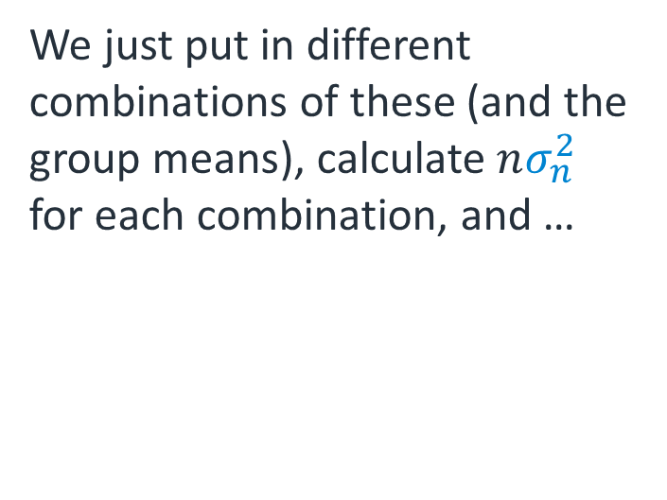
Applying this to our example
So, how do we actually use this concept?
Recall the data are:
We just put in different combinations of these (and the group means), calculate $nσ_{n}^{2}$ for each combination, and …
Group | Data
A | 2 | 4
B | 4 | 5 | 6
C | 2 | 3 | 9 | 10

Slide 63

Applying this to our example
Group | Data
A | 2 | 4
B | 4 | 5 | 6
C | 2 | 3 | 9 | 10
First up, put all 9 in.
We will want $\overline{x}$ and $nσ_{n}^{2}$ (this is for the Total).
You should get 5 and 66.

Slide 64
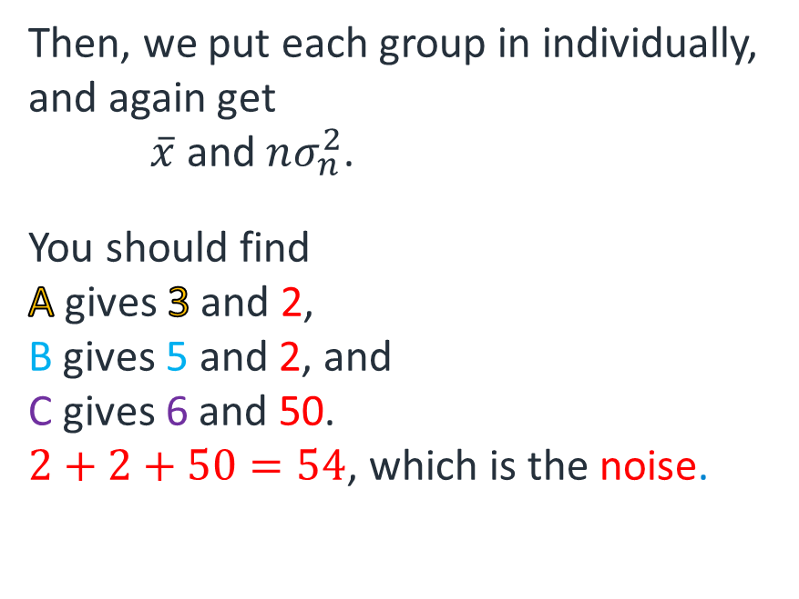
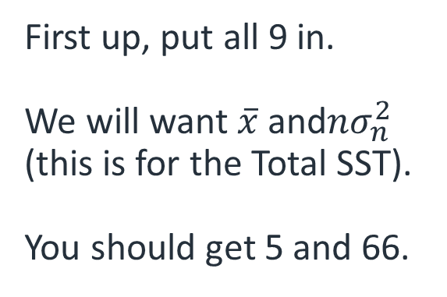
Applying this to our example
Group | Data
A | 2 | 4
B | 4 | 5 | 6
C | 2 | 3 | 9 | 10
Then, we put each group in individually, and again get $\overline{x}$ and $nσ_{n}^{2}$.
You should find
A gives 3 and 2,
B gives 5 and 2, and
C gives 6 and 50.
$2+2+50=54$, which is the noise.
First up, put all 9 in.
We will want $\overline{x}$ and$nσ_{n}^{2}$ (this is for the Total SST).
You should get 5 and 66.

Slide 65
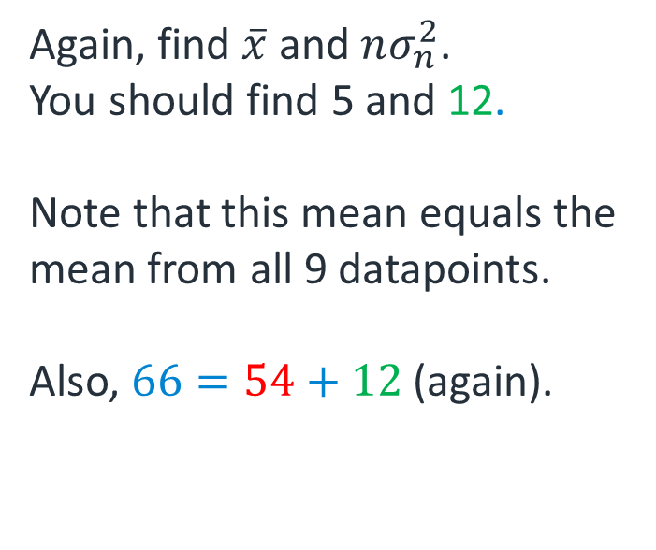
Applying this to our example
Group | Data
A | 2 | 4
B | 4 | 5 | 6
C | 2 | 3 | 9 | 10
Again, find $\overline{x}$ and $nσ_{n}^{2}$.
You should find 5 and 12.
Note that this mean equals the mean from all 9 datapoints.
Also, $66=54+12$ (again).
Lastly, we put in the means with the group sizes as frequencies:
Mean | Freq
3 | 2
5 | 3
6 | 4

Slide 66
Applying this to our example
This all puts us in the same place as after the diagrams:
Finding the degrees of freedom, mean sums of squares and the test statistic remain exactly the same.
Source | SS | df | MSS | F
Groups (Signal) | 12
Errors (Noise) | 54
Total | 66

Slide 67
Last time – summary
Source | SS | df | MSS | F
Groups (SSG) | 12 | 2 | 6 | 0.667
Errors (SSE) | 54 | 6 | 9
Total (SST) | 66 | 8
÷
=
–
=
+
+
÷
=
=
=

Slide 68
Exercise – the training times needed for the three systems (1)
An important factor in selecting software for word processing and database management systems is the time required to learn how to use a particular system. In order to evaluate three file management systems, a firm devised a test to see how many training hours were needed for five of its word processing operators to become proficient in each of three systems.
System A 16 19 14 13 18
System B 16 17 13 12 17
System C 24 22 19 18 22
Using a 5% level, is there any difference between the training times needed for the three systems? (CV=3.89)

Slide 69
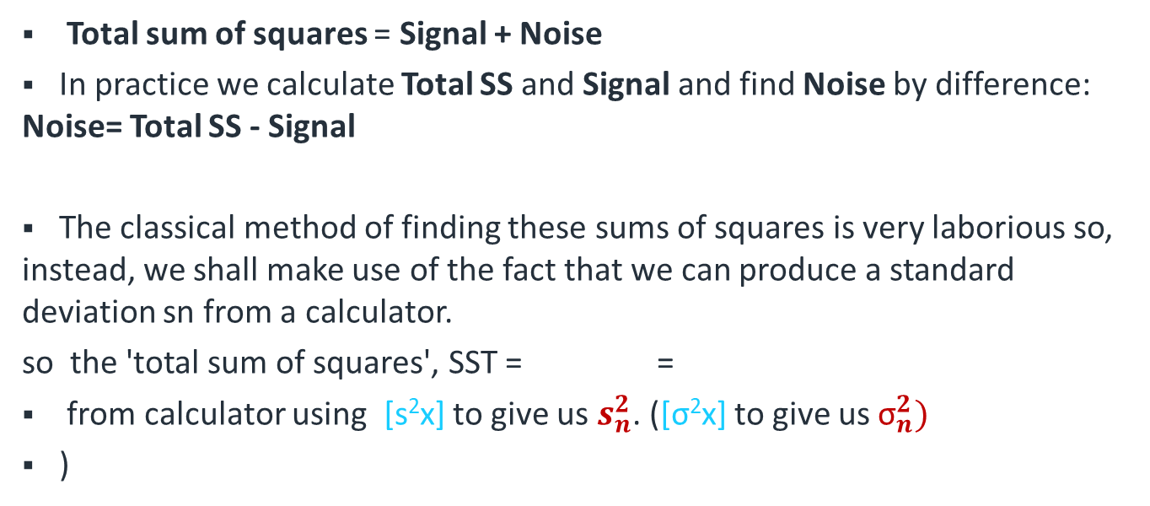


Exercise – the training times needed for the three systems (2)
Total sum of squares = Signal + Noise
In practice we calculate Total SS and Signal and find Noise by difference: Noise= Total SS - Signal
The classical method of finding these sums of squares is very laborious so, instead, we shall make use of the fact that we can produce a standard deviation sn from a calculator.
so the 'total sum of squares', SST = =
from calculator using [s²x] to give us $s_{n}^{2}$. ([σ²x] to give us ${\text{σ}}_{n}^{2})$
)
$$s_{n} = \sqrt{\frac{\sum{{\left(x−\bar{x}\right)}^{2}}}{n−1}}$$
$$(n−1)s_{n}^{2}$$

Slide 70
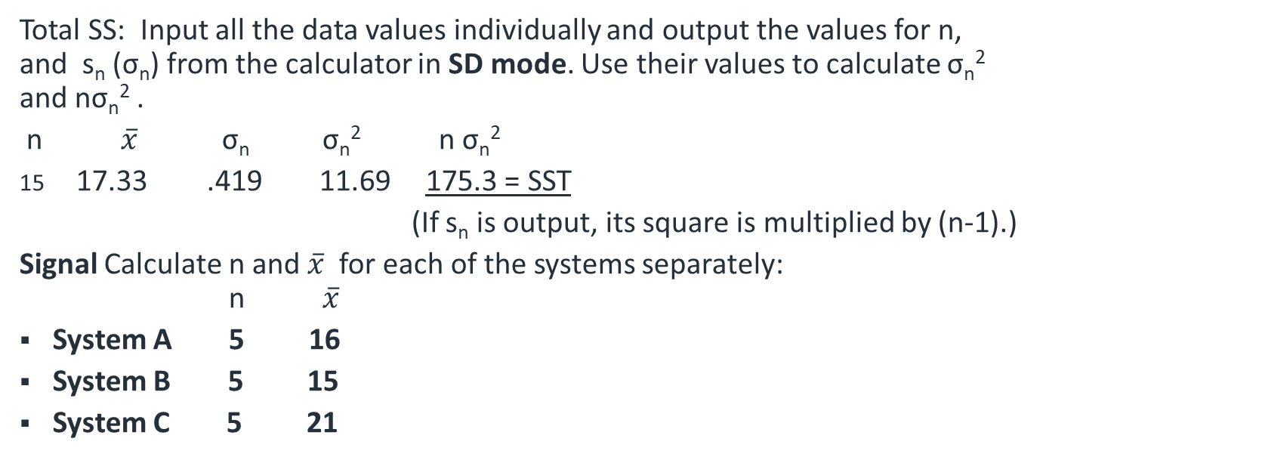
Exercise – the training times needed for the three systems (3)
Total SS: Input all the data values individually and output the values for n, and s_{n} (σ_{n}) from the calculator in SD mode. Use their values to calculate σ_{n}² and nσ_{n}² .
n $\overline{x}$ σ_{n} σ_{n}² n σ_{n}²
17.33 .419 11.69 175.3 = SST
(If s_{n} is output, its square is multiplied by (n-1).)
Signal Calculate n and $\overline{x}$ for each of the systems separately: n $\overline{x}$
System A 5 16
System B 5 15
System C 5 21

Slide 71
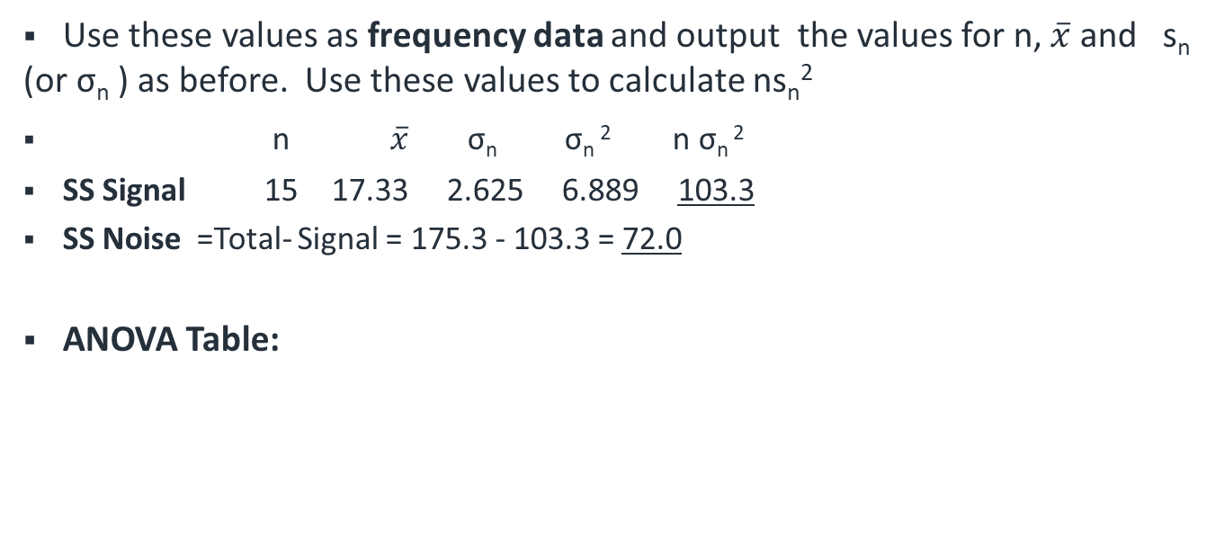
Exercise – the training times needed for the three systems (4)
Use these values as frequency data and output the values for n, $\overline{x}$ and s_{n} (or σ_{n} ) as before. Use these values to calculate ns_{n}²
n $\overline{x}$ σ_{n} σ_{n} ² n σ_{n} ²
SS Signal 15 17.33 2.625 6.889 103.3
SS Noise =Total- Signal = 175.3 - 103.3 = 72.0
ANOVA Table:
Notes:
The mean sum of squares (MSS) is the sum of squares (SS) divided by the degrees of freedom on each line.
The test statistic F is the mean sum of squares for the systems divided by the mean sum of squares for the errors

Slide 72
Exercise – Solution
H₀:
H₁: At least two means are different.
Critical value: F_{0.05} (2,12) = 3.89
Test Statistic: 8.60
Conclusion: T.S. > C.V. so reject H₀ . There is a difference between at least two of the systems.

Slide 73
Conclusions from ANOVA
ANOVA tests if there is a significant difference between the means of the groups.
We can either:
find a difference
not find a difference
If we do, we still don’t know which group(s) was/were different, nor whether it/they was/were more or less than the others.
Tests do exist to work this out. ANOVA typically covered again in more advanced stats courses.

